Slide 1
House and Grounds Committee
A few sketches of projects under consideration.

Slide 2
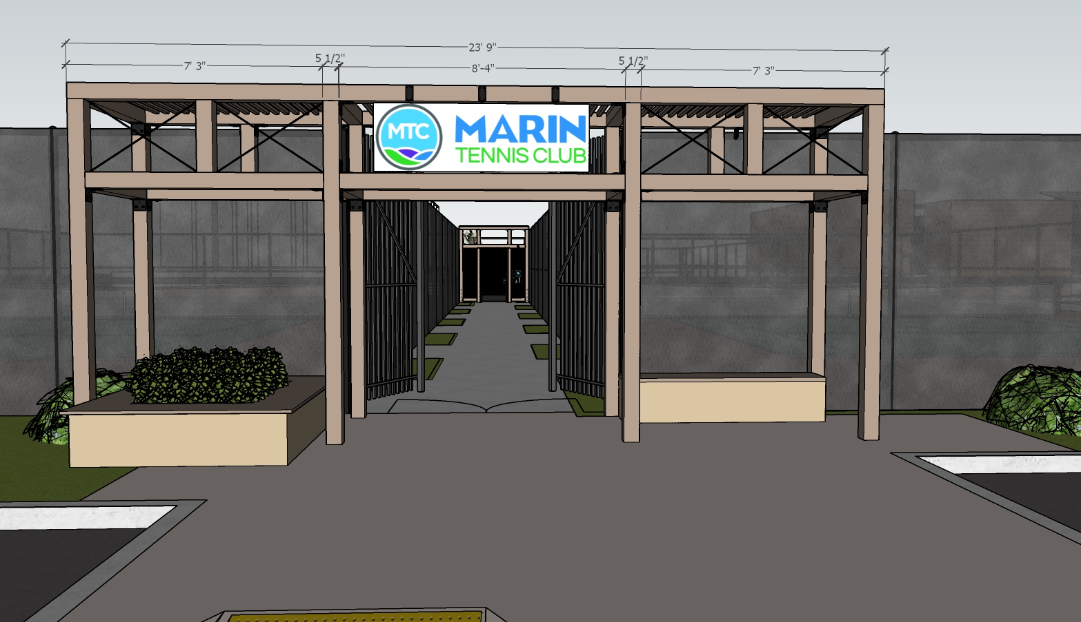
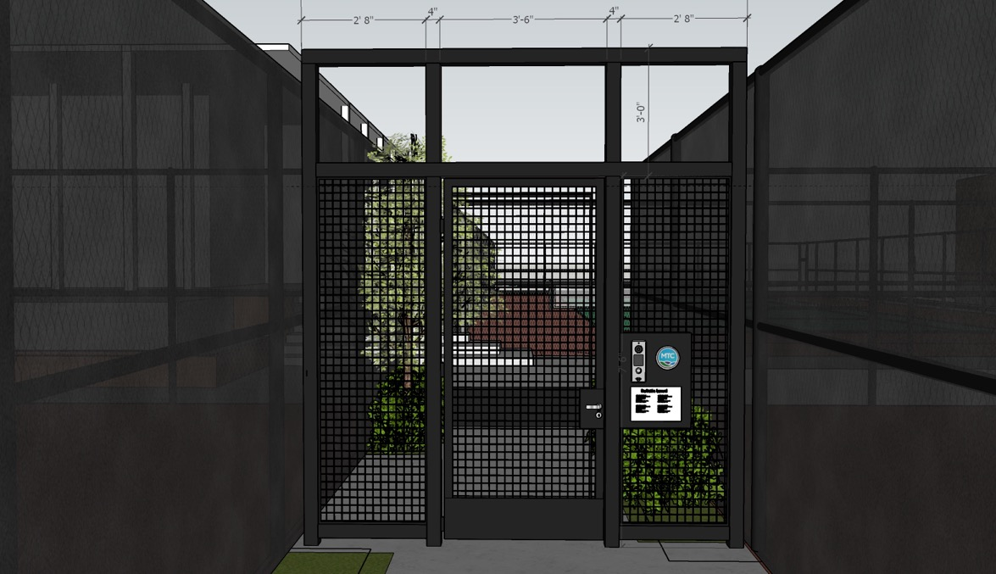
Entry Trellis
Trumpet Vines would be planted on either side and trained to grow over the top of the trellis. A mini-clubhouse look.

Slide 3
Access Control Gate
This gate would be located a few big posts back from the end of the entry walkway. It will close quietly!

Slide 4
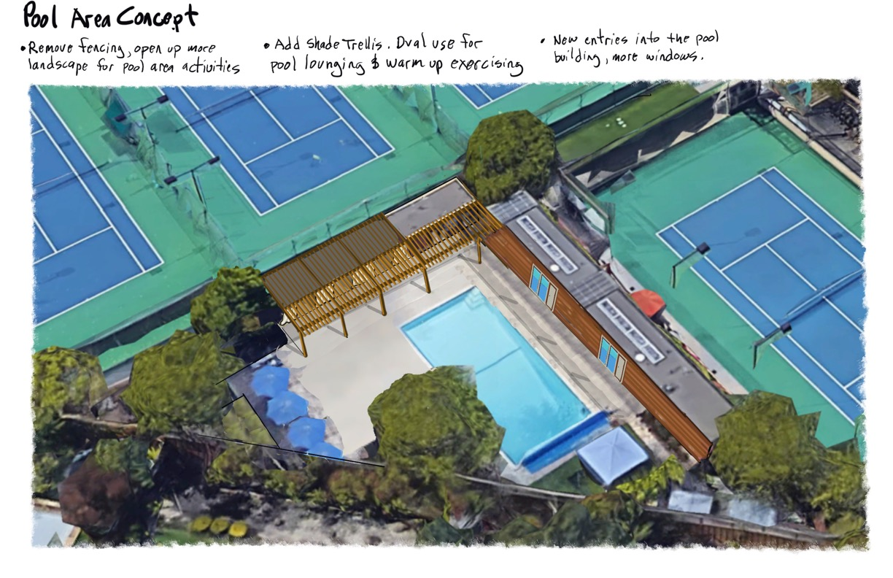

Slide 5
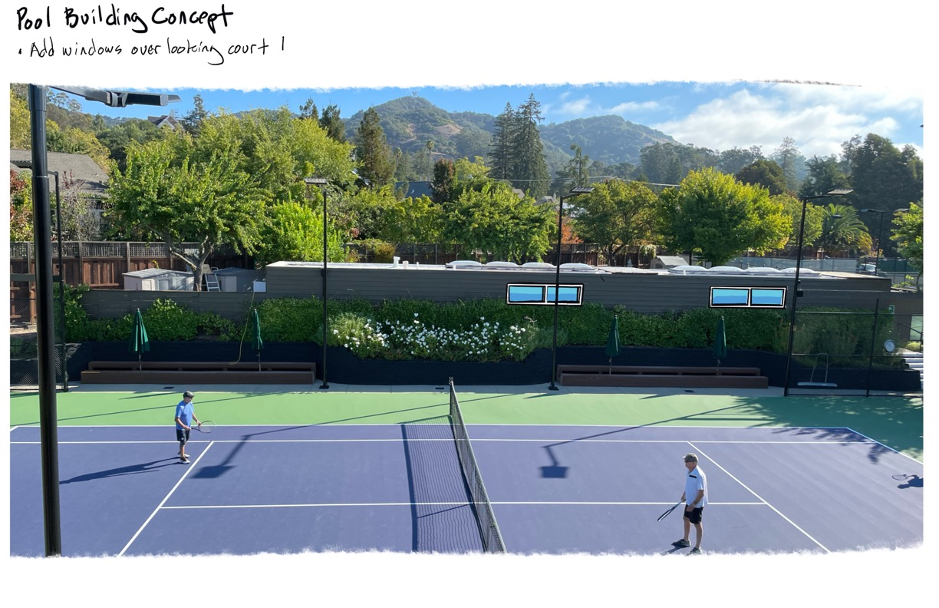

Slide 6
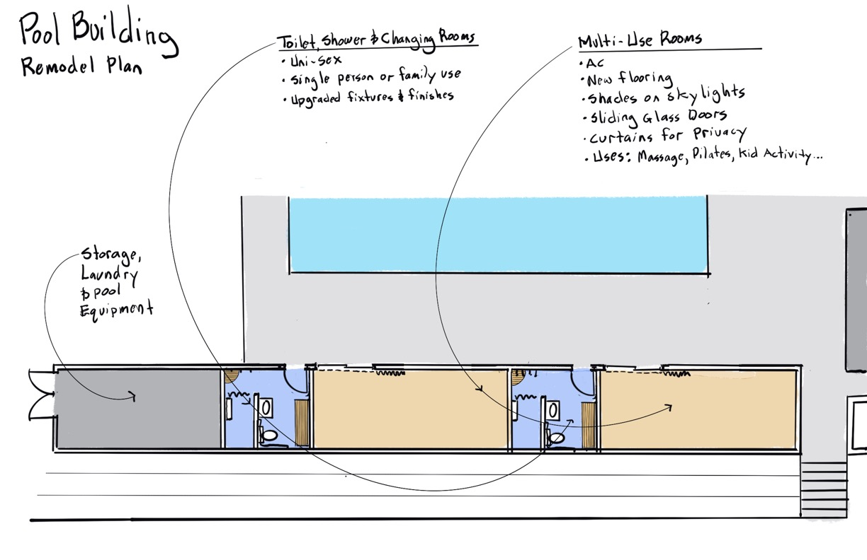

Slide 7
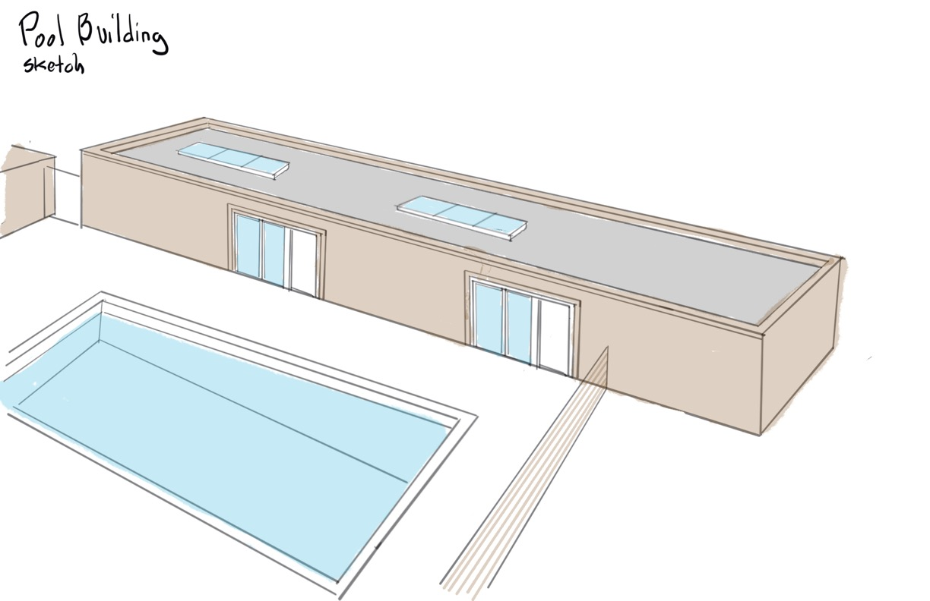

Slide 8
Lazy Acres
A shaded area for barbeques, socializing and Court 1 viewing

