Slide 1

Welcome to the
Marin Tennis Club
New Members and Upcoming Events

Slide 2



IN VIEW
ON THE HORIZON …
Monday Bridge @ 5:45pm
EC Meet @ 5:15pm
STC Meet @ 6:15pm
Tuesday …
Wednesday …
Thursday Board Meet @ 6pm
Friday …
Saturday Social Court 10am-12noon
18MX7.0B @ 1pm; 18MX7.0A @ 2pm
55AM7.0B @ 3pm; 55AW8.0A @ 4pm
Sunday Hosted Drop In 10am -12:30pm
18MX8.0B @ 1pm; 55AM8.0A @ 2pm
Save the Dates!!
Saturday Sep 12th
GOURMET TENNIS
Sunday Sep 13th
JUNIOR/ADULT TOURNEY

Slide 3
NEW/newish MTC MEMBERS
Please check with the office for an important document!!
Kushal Chakrabarty
Katharine Fisher
Molie Malone
Robert Napoles
Barry Robbins
Kevin Sun
THE ALL NEW 2015 HANDBOOK & DIRECTORY IS HERE – PLEASE ASK for YOUR COPY
Reminder, we have the 2015 Member Handbook, and a regularly updated sheet listing all new members – please ask for a copy

Slide 4
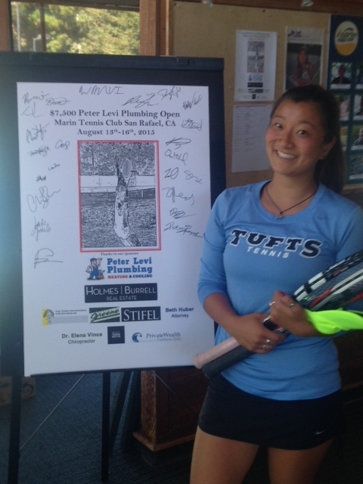
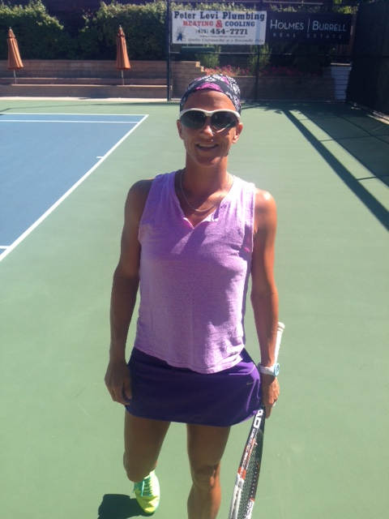
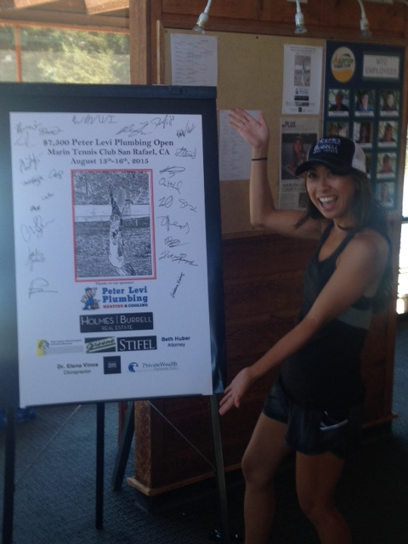
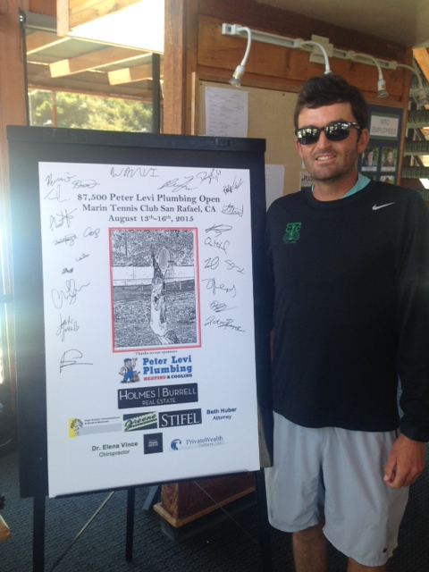
$7,500 Peter Levi Plumbing Open
Also Presented by Holmes Burrell Real Estate
Many thanks to all the MTCers who supported this great event, with good crowds gathered each day of matches. Congrats to the winners in the singles divisions who each took home $1,500 in prize money, and thanks to all the participants and organizers for bringing such quality tennis to our courts.

Slide 5

SIGN-UP ONLINE NOW!!
24 Players and up to 24 guests

Slide 6

What Is It? This event is open to all members who wish to play with their son/daughter, niece/nephew, grandson/granddaughter. If the junior member needs a partner, we'll help find them one!
What time? from 2pm to 5pm-ish
What's the Format? Expect to play 3 matches of a first to 8 games set. We will organize the matches putting teams of similar skill sets together.
What's Provided? MTC provides balls, we'll serve pizza and refreshments for all entrants!!
The Cost? $17 per team
How to Sign-up? Please sign-up here at the office or email manager@marintennisclub.org
and provide name and play level of both junior and adult players!!
MTC 2015 Junior/Adult Doubles Tournament
Sunday September 13th
Juniors 17 years old and under

Slide 7
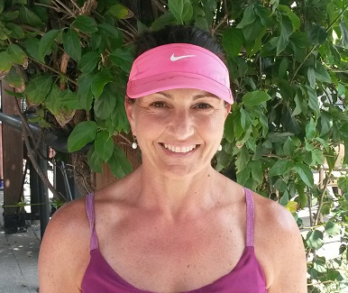
Katharine Fisher - Level: 4.0
Joined August 2015

Slide 8
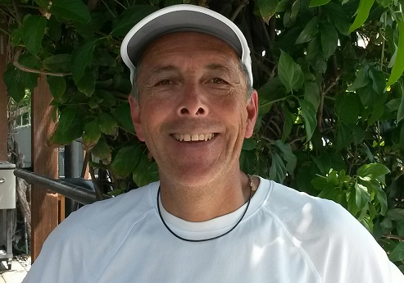
Robert Napoles - Level: 4.0
Joined July 2015

Slide 9
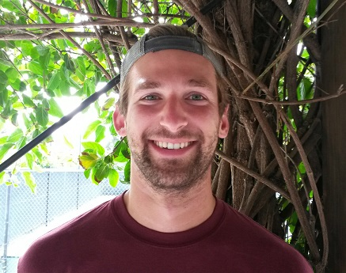
Jack Trimble - Level: 4.0
Joined June 2015

Slide 10
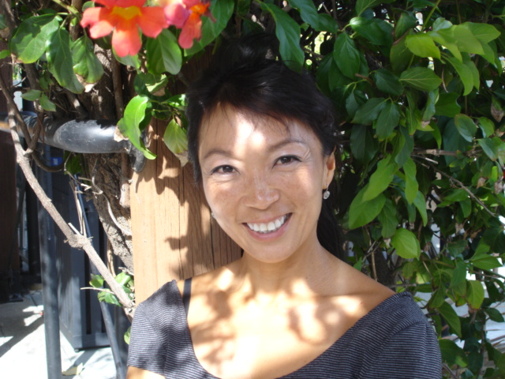
Bee Tan - Level: 3.5
Joined May 2015

Slide 11
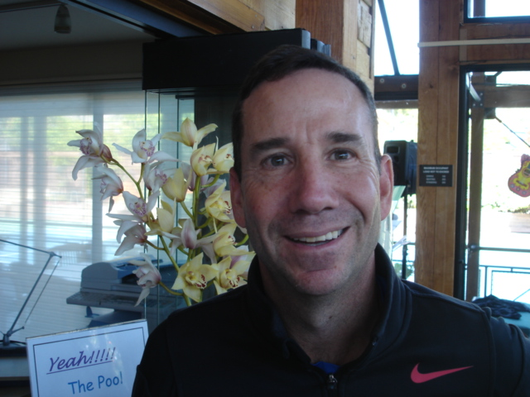
Geoff Barnet-- Level: 4.0
RE-Joined April 2015

Slide 12
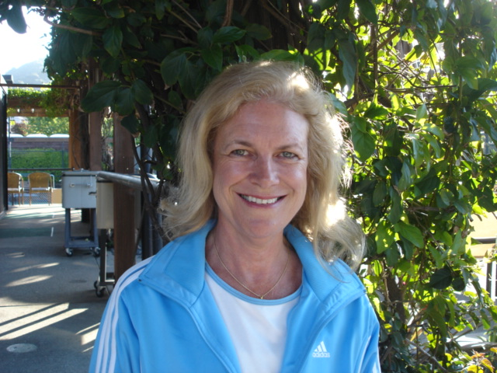
Lori Payne -- Level: 3.5
Joined April 2015

Slide 13
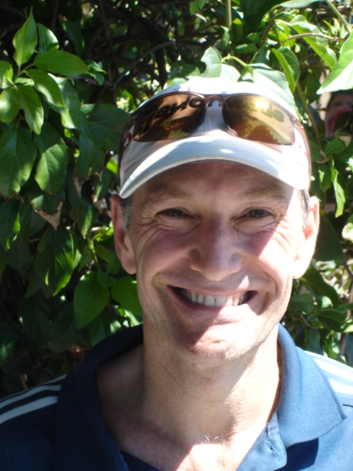
Elliot Morshead
Joined March 2015
Level: 4.0

Slide 14
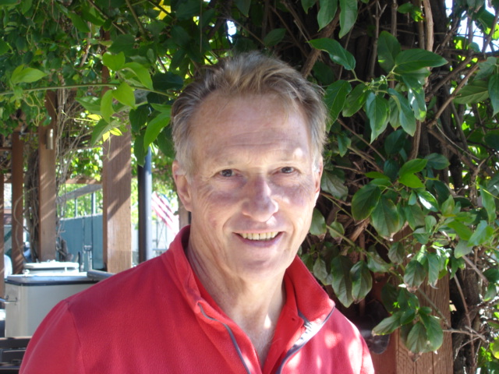
John Miller
Joined March 2015
Level: 3.5

Slide 15
ARE YOU READY TO SERVE?
OPPORTUNITY TO JOIN AN MTC STANDING COMMITTEE!!
Committees always welcome new members to bring fresh ideas …
Focus on specific aspect of the clubs operations …
Meet just once a month, usually in the early evening …
Membership team is looking to add a couple of new faces!!
If you have an interest in serving on one or more committees, please contact either the respective chair or the GM.
COMMITTEE
Tennis
Social Tennis
Membership
House & Grounds
Finance
Entertainment
CHAIR
Joan Corbett
Herb Gottlieb
Steve Stadnicki
Ron Pejooh
Terry Cush
Beth Huber

